Slide 1
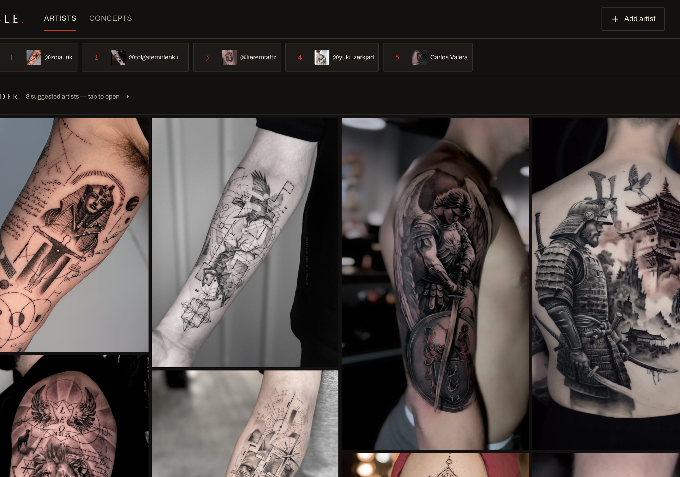
SABLE
HOW I USE AI · BUILDING SOFTWARE
One developer, a fleet of agents
A tattoo collector’s app, built with Claude Code, Codex and Antigravity. March to October 2026.

Slide 2
From issue to merge
All work comes from one GitHub backlog. Claude, Codex and the other models all pick their tasks from it.
01
02
03
04
05
Backlog
Agent
Critics
CI
Merge
Every task is a GitHub issue labelled backlog. A model claims one with an in-progress label.
Claude Code or Codex writes the tests first, in its own git worktree. Several run in parallel.
Codex and Antigravity review the diff, read-only. I verify every finding.
Vitest, Playwright browser tests, CodeQL and SonarQube.
Squash-merge, deploy to GitHub Pages, smoke-test the live demo.
56 of 58 tasks passed CI on the first run.
From the ledger’s task records, alongside 40 cross-model review runs.

Slide 3
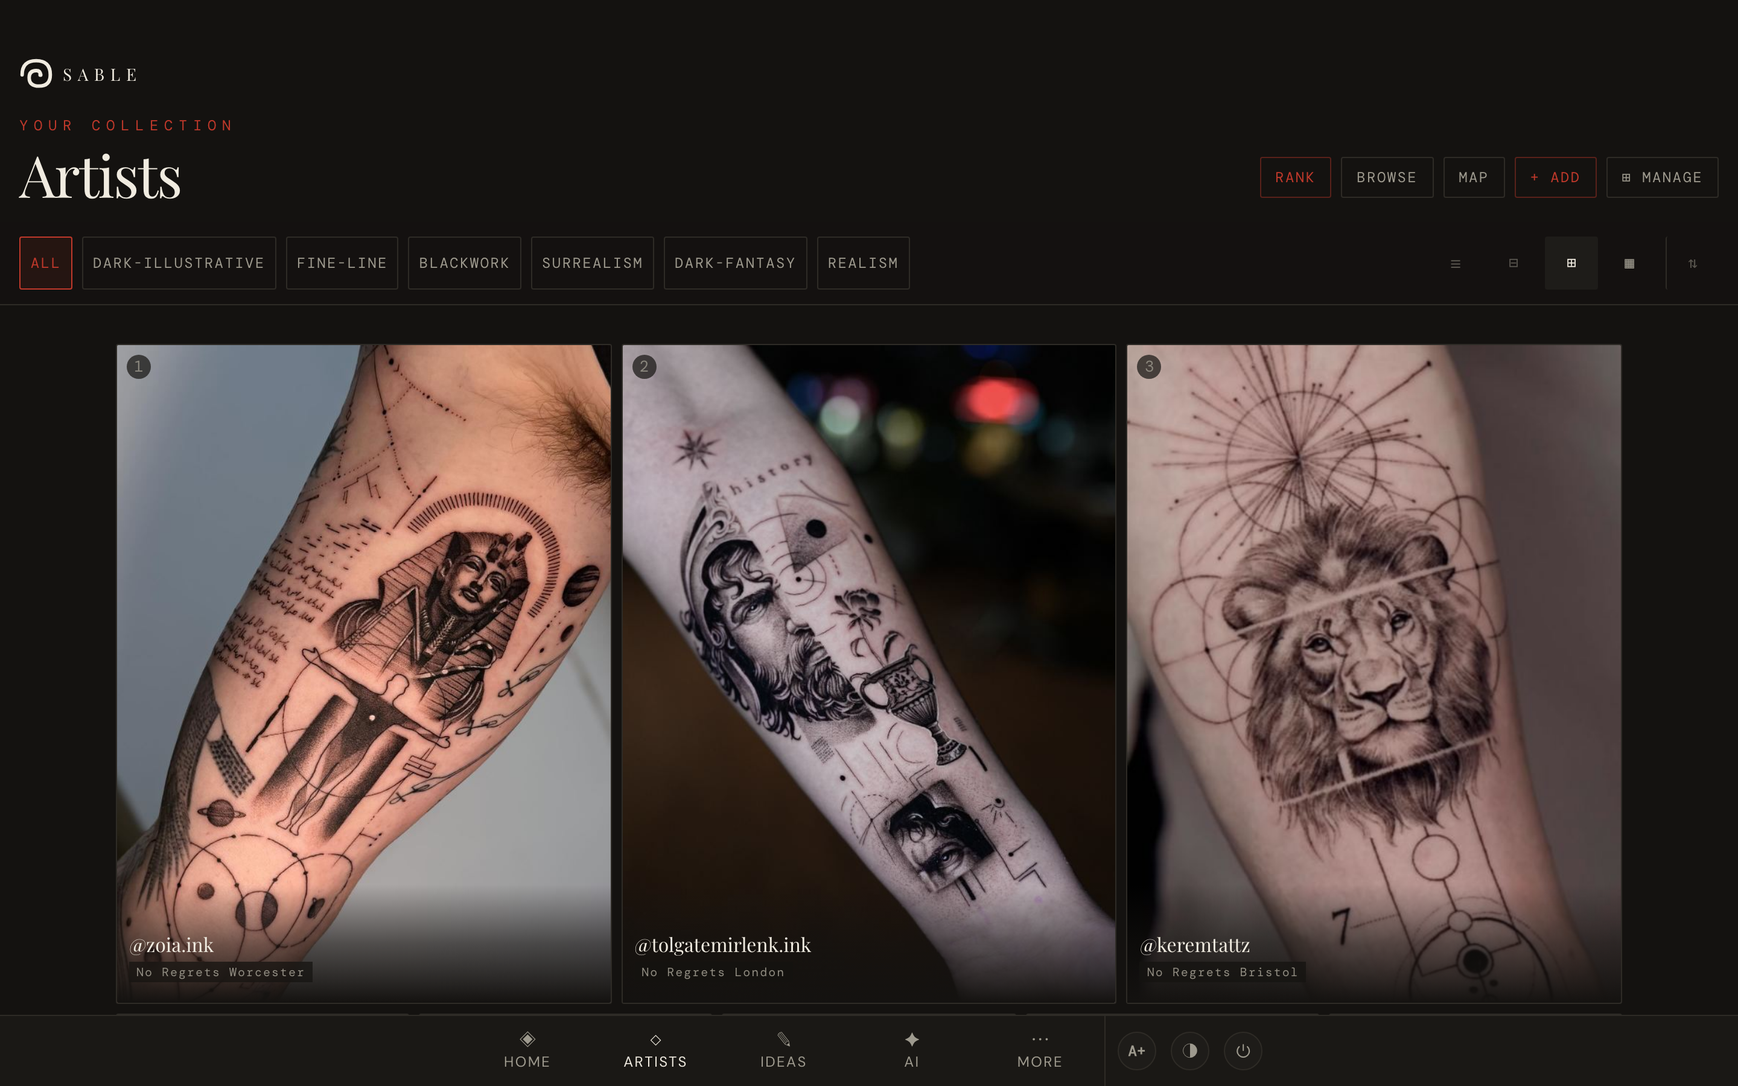
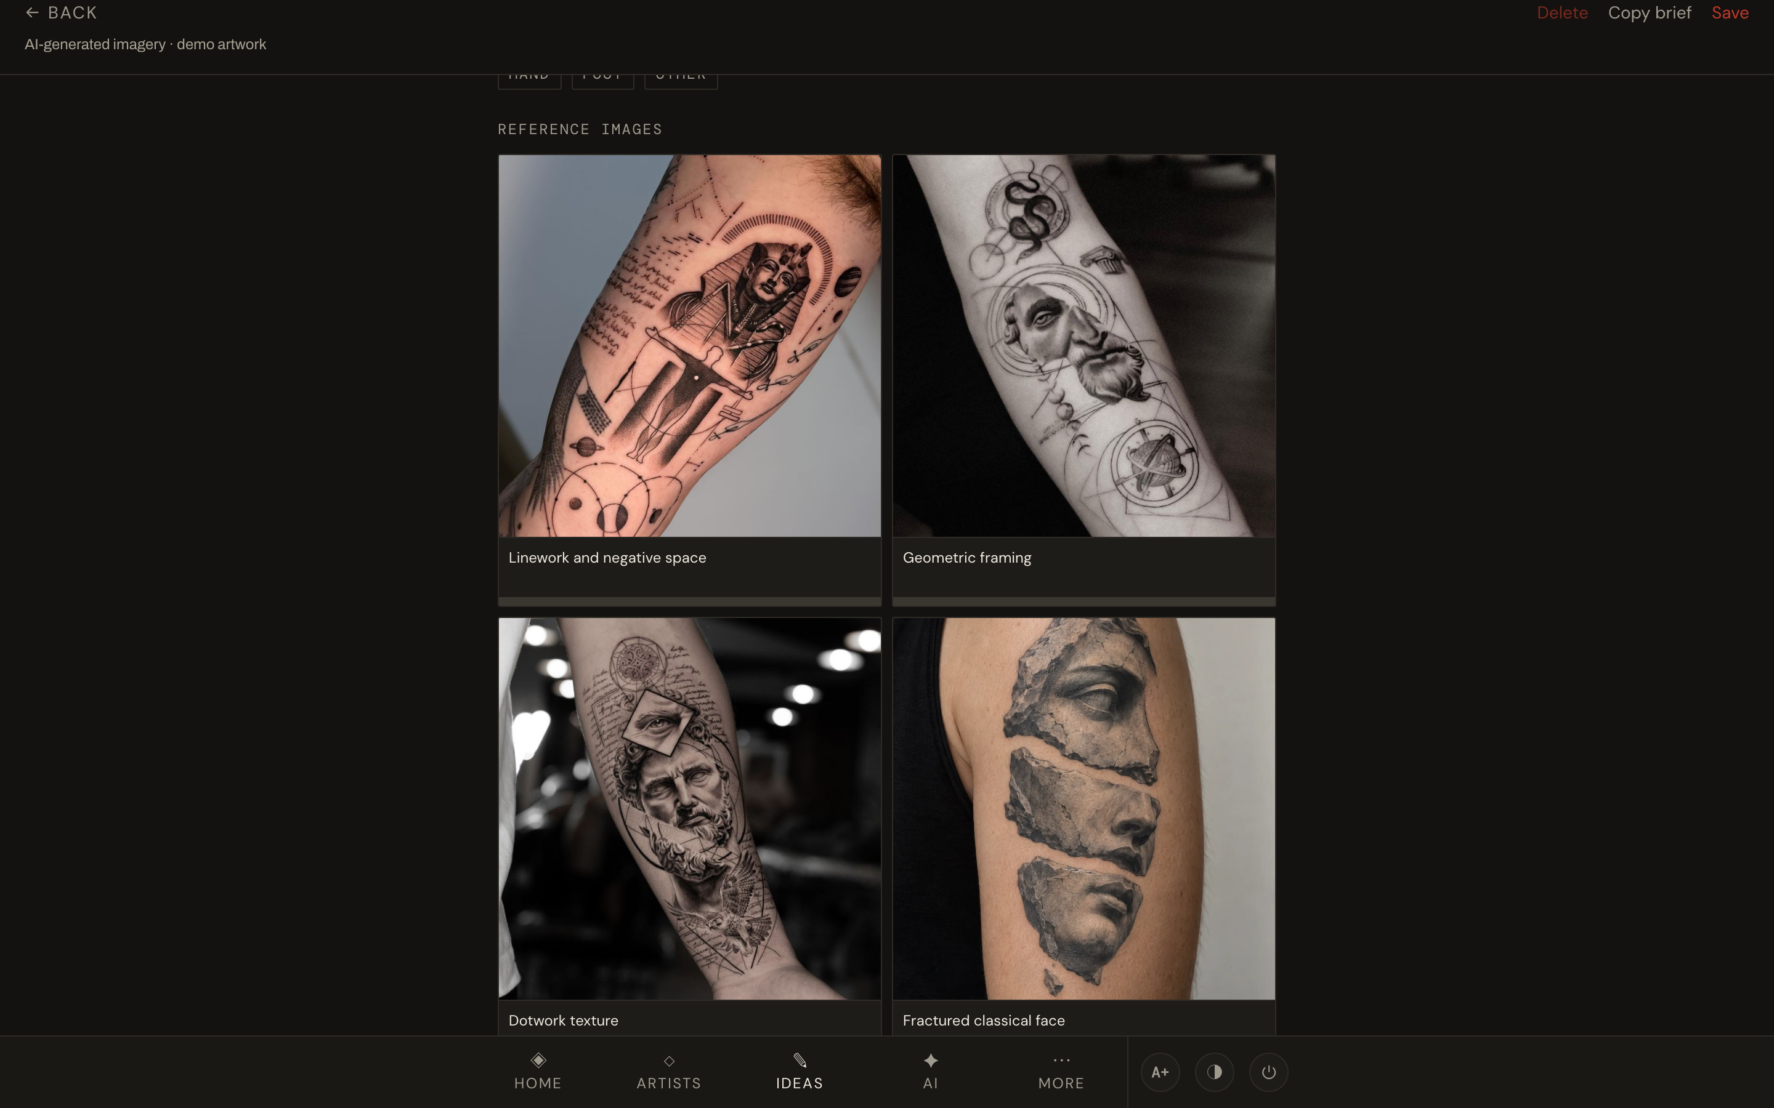
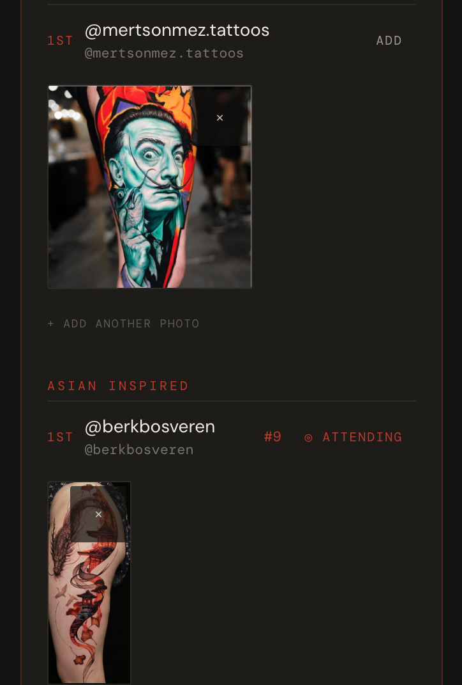
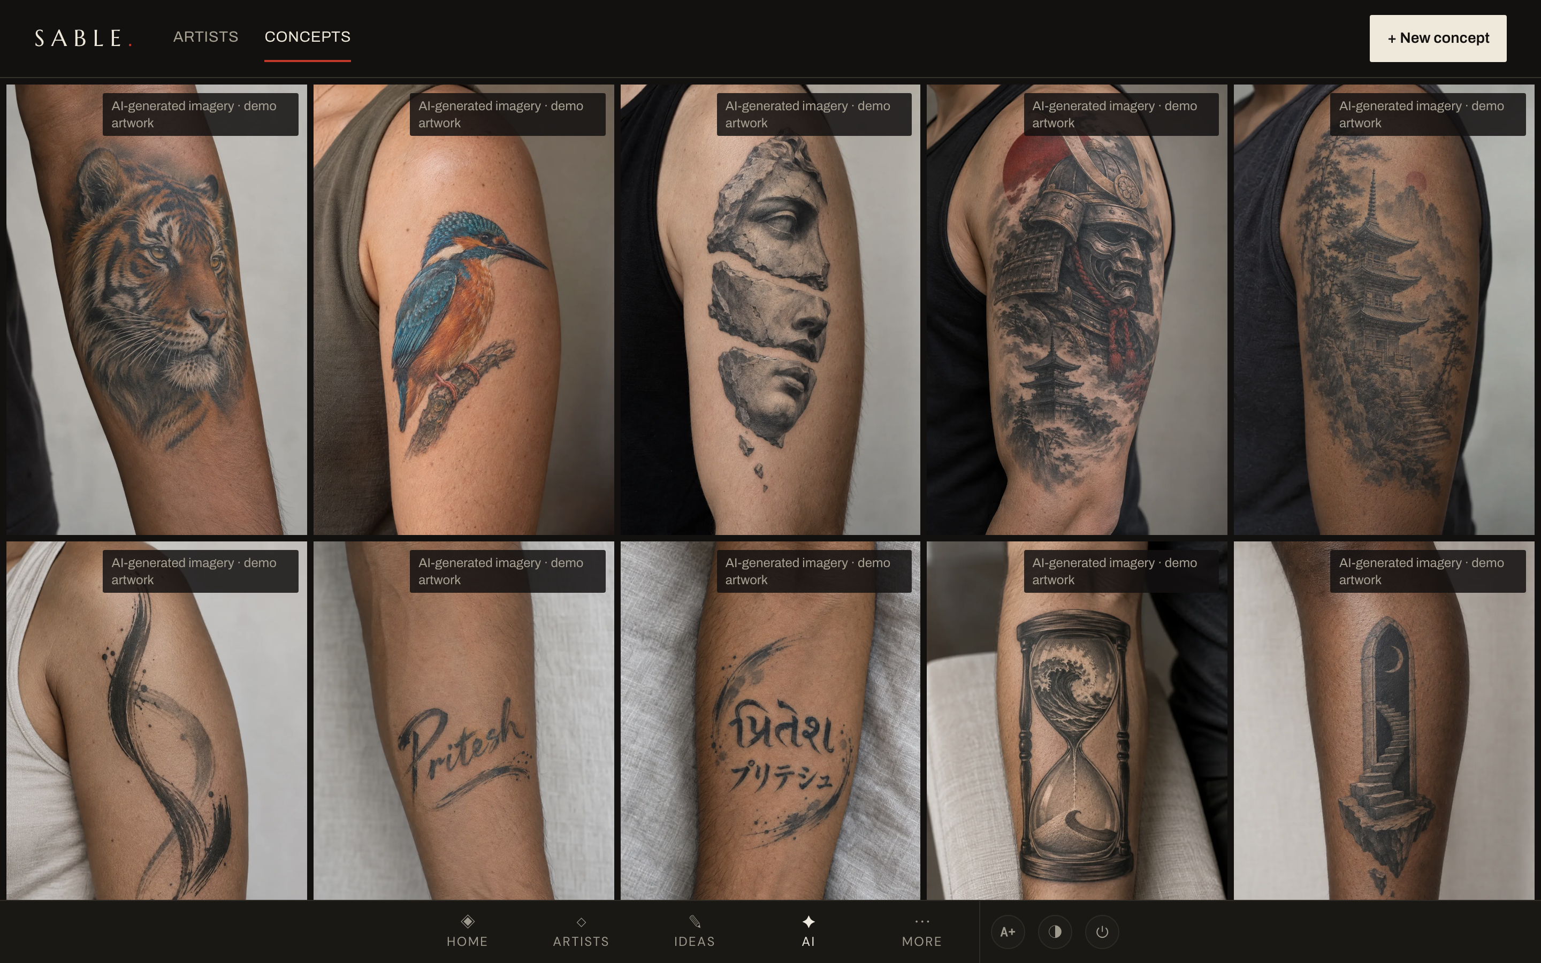
Every tattoo artist I love, in one place
Artists
Ideas
Radar
AI concepts
448
92
248
25k
commits since 18 March
GitHub issues closed
test files, unit and browser
lines of app source
React 19 · React Router 8 · Tailwind 4 · Vite 8 · installable web app with sync · on-device CLIP taste matching · Gemini vision screenshot intake

Slide 4
What’s inside
OpenAI · Gemini
STL · in the browser
CLIP · on-device
AI concepts
3D relief export
Similar ink
Describe a tattoo and generate it with my own key, or copy the prompt into any chatbot.
Any concept image becomes a 3D-printable relief, built on the device.
Finds artists whose work looks like the ones I love, and maps my whole gallery by look.
Share sheet · Gemini vision
Bookmarklet · strict parsers
Local-first · sync
Screenshot intake
Convention Radar
Works offline
Share an Instagram screenshot to Sable and the new artist’s details fill themselves in.
Pulls in a show’s 466-artist line-up or its winners board, and flags the artists I already follow.
Edits and photos save on the device first, then sync when there’s a connection.

Slide 5
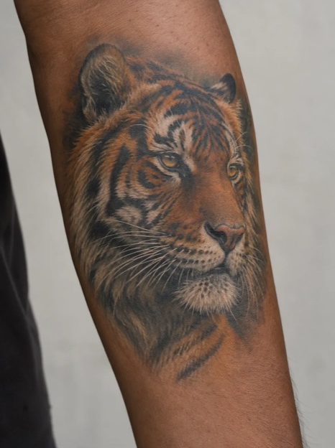
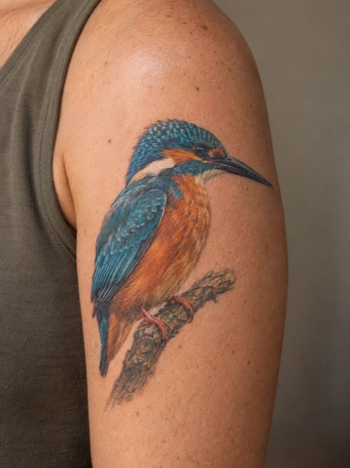
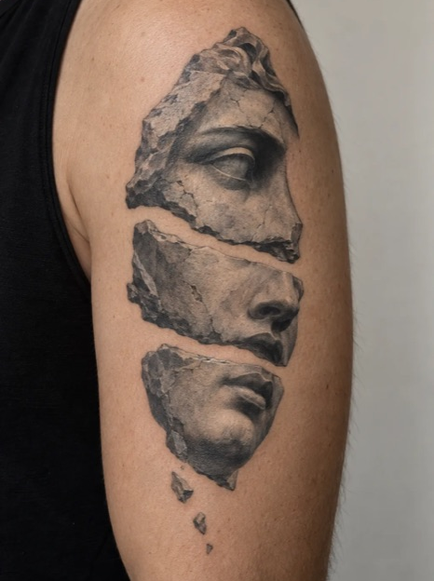
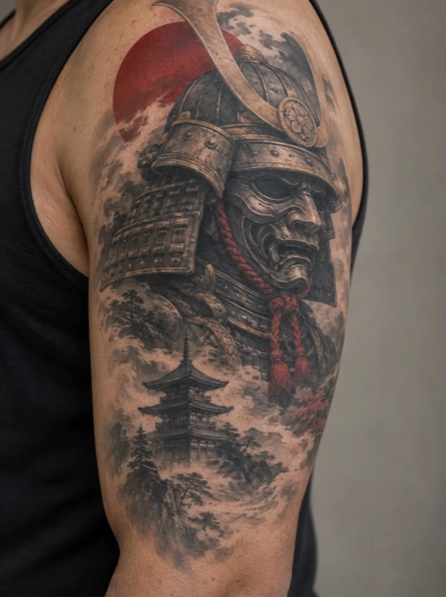
The other models in the loop
OPENAI · CODEX
OPENAI · CODEX
GOOGLE · ANTIGRAVITY
The artist
The correctness critic
The design critic
Generated all 18 demo tattoos with gpt-image. It writes code too, in its own worktrees.
Reviews every medium or large diff, read-only: bugs, security, edge cases. It has caught real state bugs before merge.
Reviews plans, UX and strategy. Caught an embedding-quality issue in the taste engine. Gemini also reads Instagram screenshots inside the app.
codex exec --sandbox read-only
agy --print
About 1 in 5 critic findings is confidently wrong, so I check every one.

Slide 6
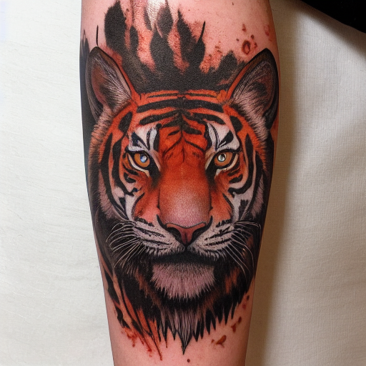

Same subject, two image models
Local is fine for placeholders and test images.
The demo has to sell the app, so it got the cloud model: real skin, light and fine linework.
LOCAL · MY MAC’S CPU
CLOUD · CODEX
Stable Diffusion 1.5 with Flash LoRA. 512 px in 38 seconds, offline and free.
gpt-image. 1024 × 1536, one of the 18 demo tattoos.

Slide 7
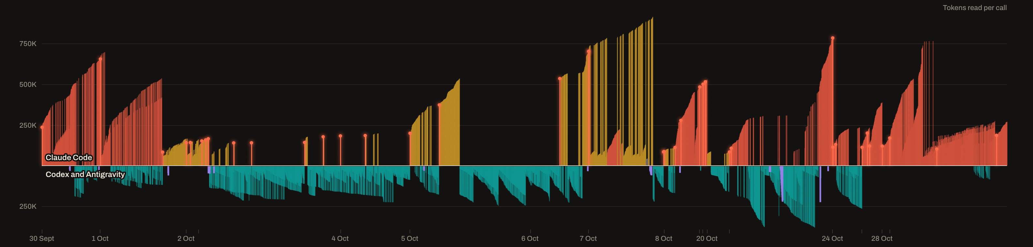
Where the tokens go
The Sable AI Ledger: every Claude Code, Codex and Antigravity call, rebuilt from local logs each morning.
Opus 5.5
Sonnet 5.5
Codex
Antigravity
Other models
Cache rebuild
Every call, 30 September to 29 October. Claude Code above the line; Codex and Antigravity below. Height is the tokens each call read.
Each ramp is one session: every reply re-reads everything before it, so it climbs until I clear it.

Slide 8
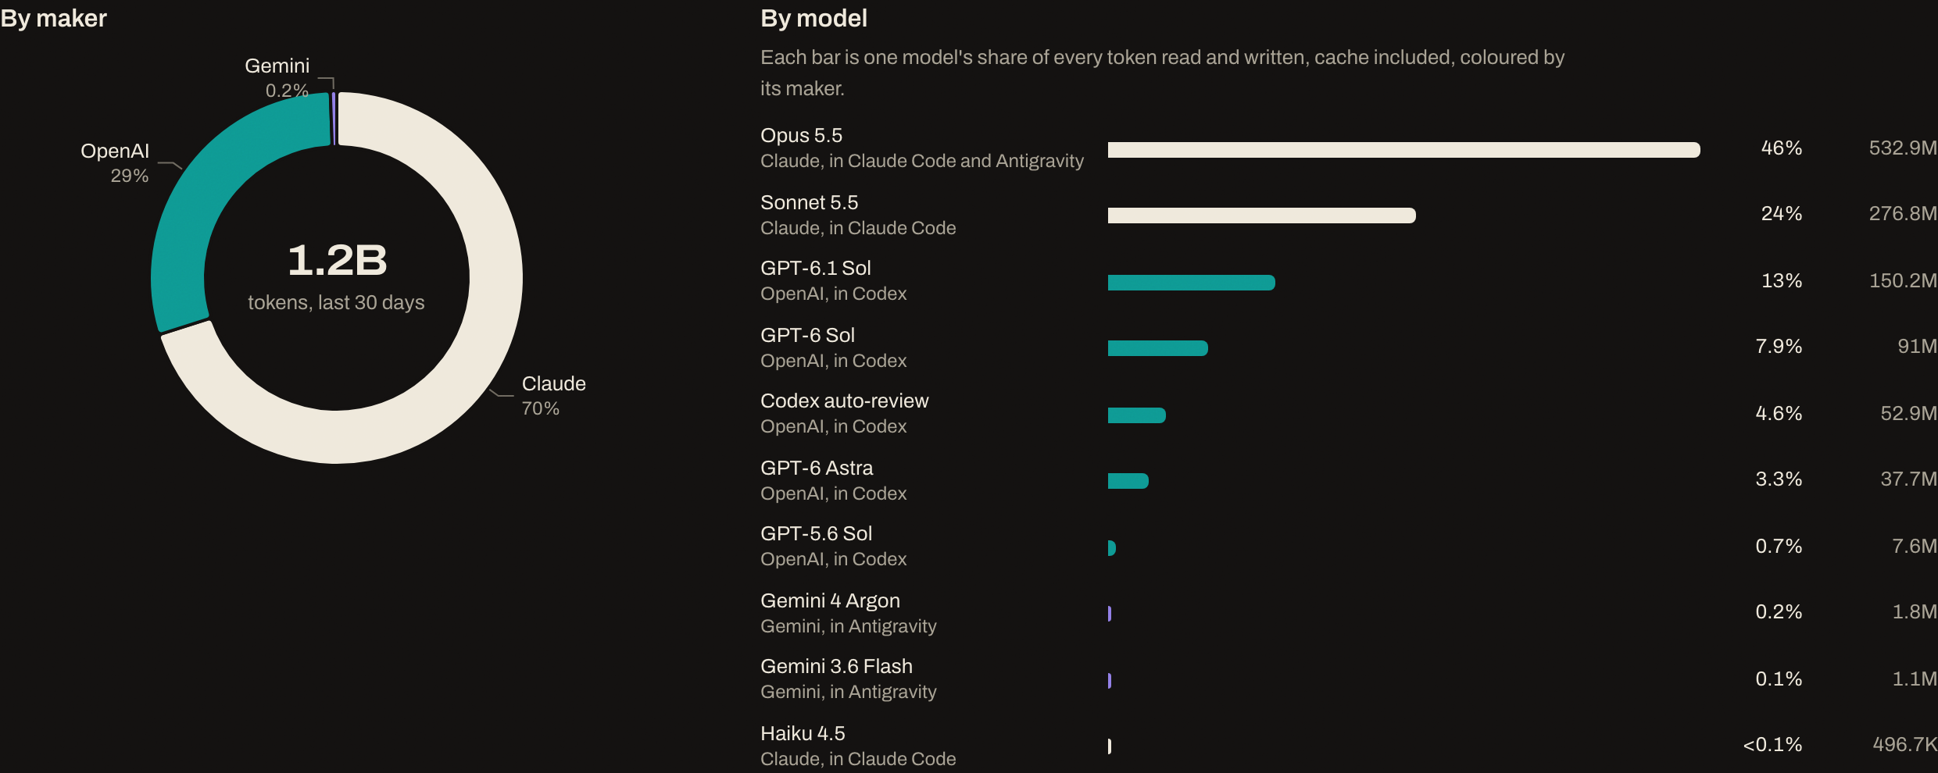
1.2 billion tokens in 30 days
Every token read and written, cache included, across Claude Code, Codex and Antigravity, 30 September to 29 October.

Slide 9
8×
Re-reading context cost eight times what the models wrote.
$279 on cache reads and writes against $35 of output and thinking, at API list prices, 30 September to 29 October.

Slide 10
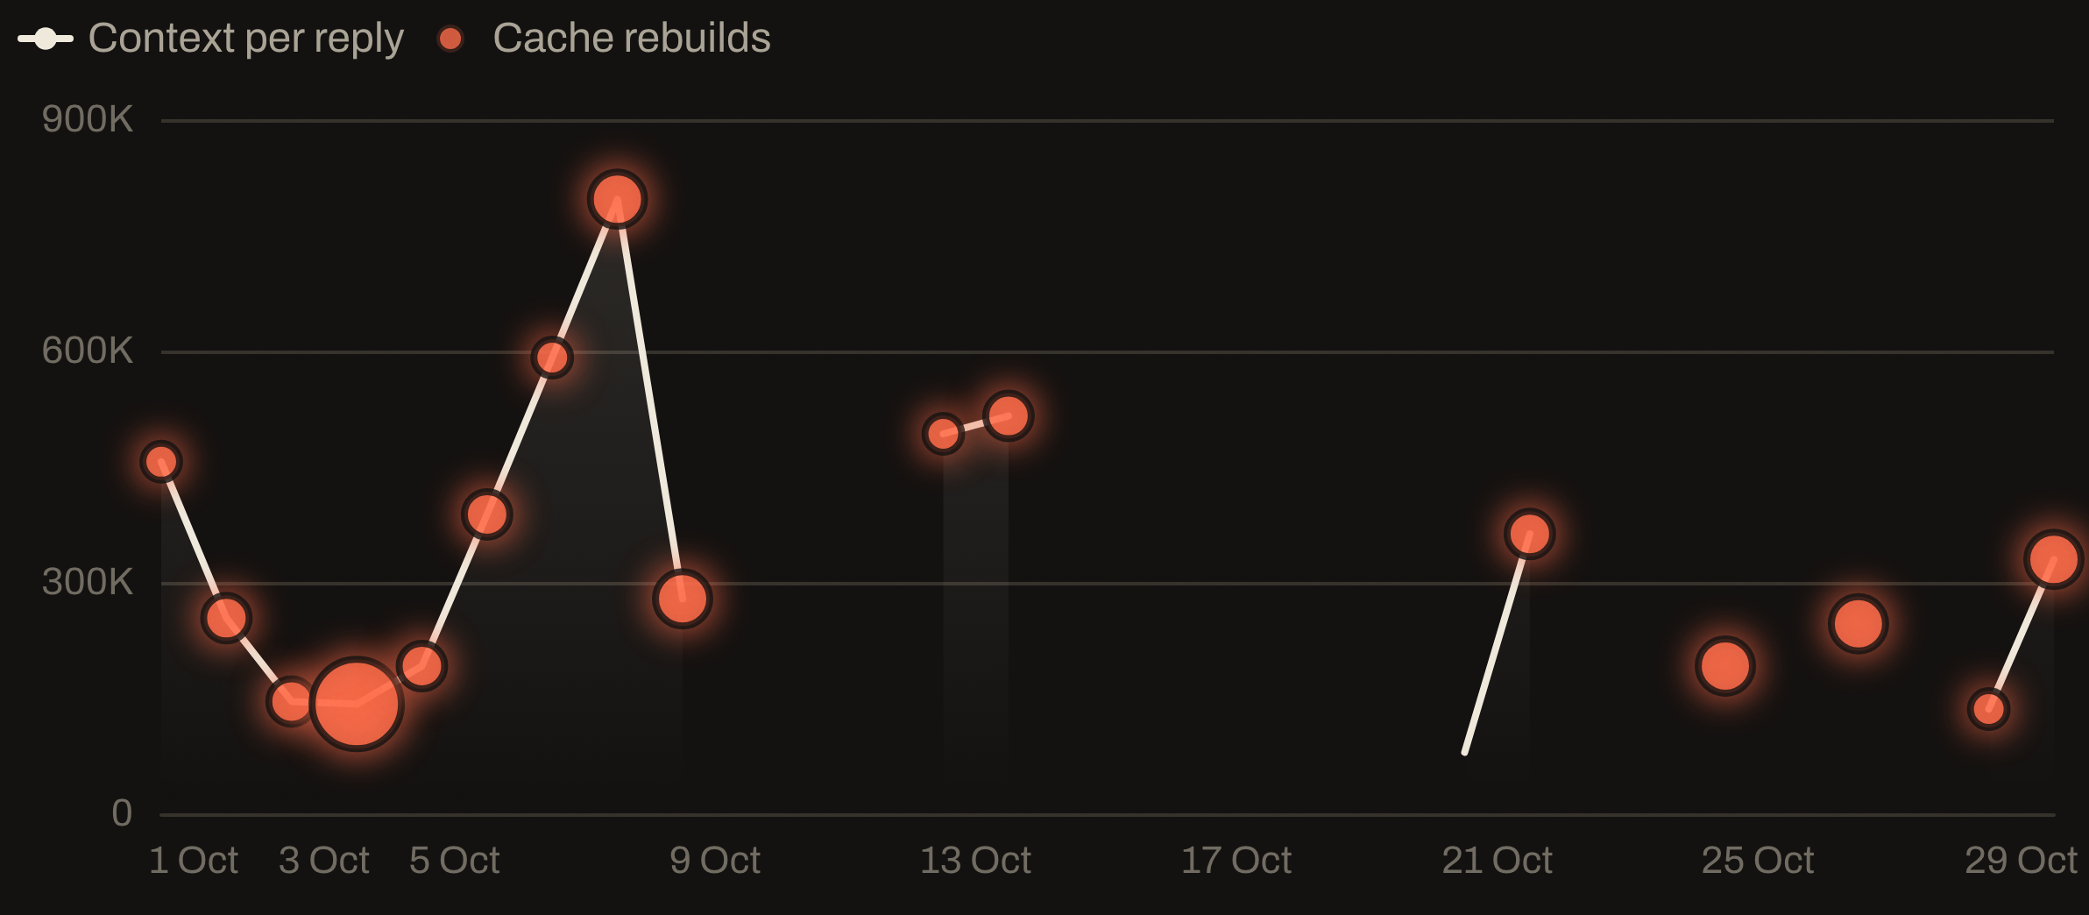
Context per reply, day by day
PEAK · 7 OCT
796K
tokens re-read by the average reply that day
SINCE 20 OCT
79–362K
Average tokens each main reply read, per day. Bubbles mark cache rebuilds, sized by how many. Gaps are days without Claude Code work.

Slide 11
What the data changed
70%
One unit of work per session
Write the handoff on the GitHub issue, then clear and start fresh.
Don’t resume after a break
of Claude spend came from just two sessions, left running for 11 and 12 days.
The prompt cache expires after an hour. 38 of 57 cache rebuilds followed a gap that long.
Wait, don’t poll
Run slow jobs in the background. Every poll re-reads the whole context.
Context per reply: 322K → 228K tokens, week on week.

Slide 12
The agents write the code. My job is the system around them.
THE TAKEAWAY
Issues, worktrees, cross-model critics, CI, and a ledger that keeps me honest about the cost.

